Slide 1

How to Identify, Verify and Choose New Suppliers and Manufacturers
Without Spending a Dime for Traveling
Prepared by: AGS-TECH, Inc.
“Your one-stop shop for custom manufacturing”
Visit us at http://www.agstech.net

Slide 2
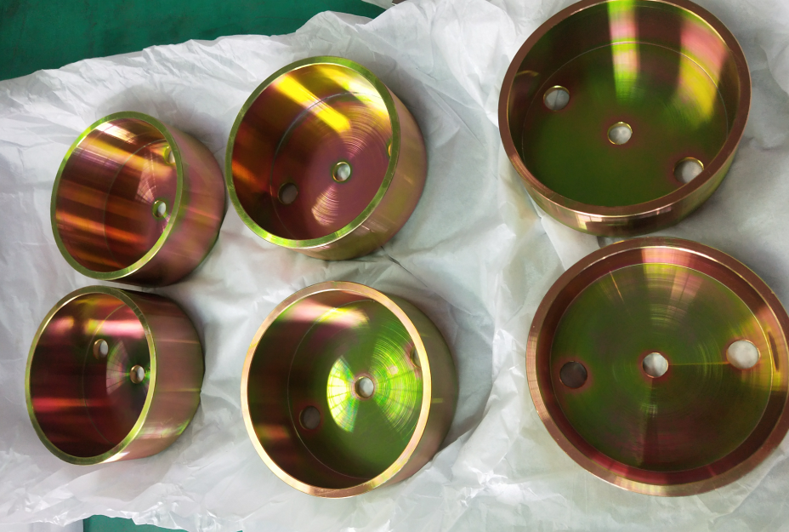
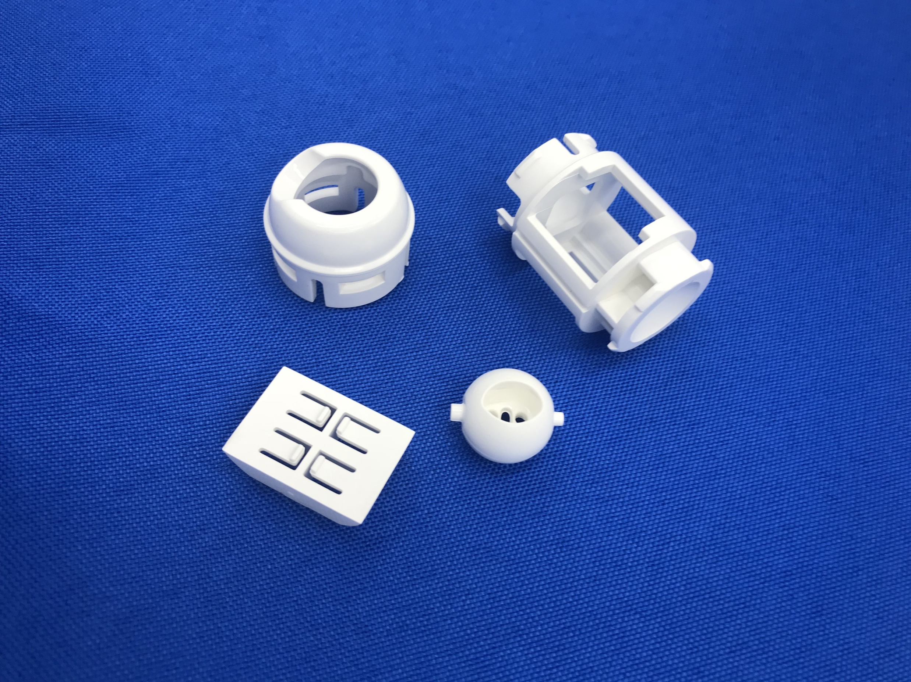
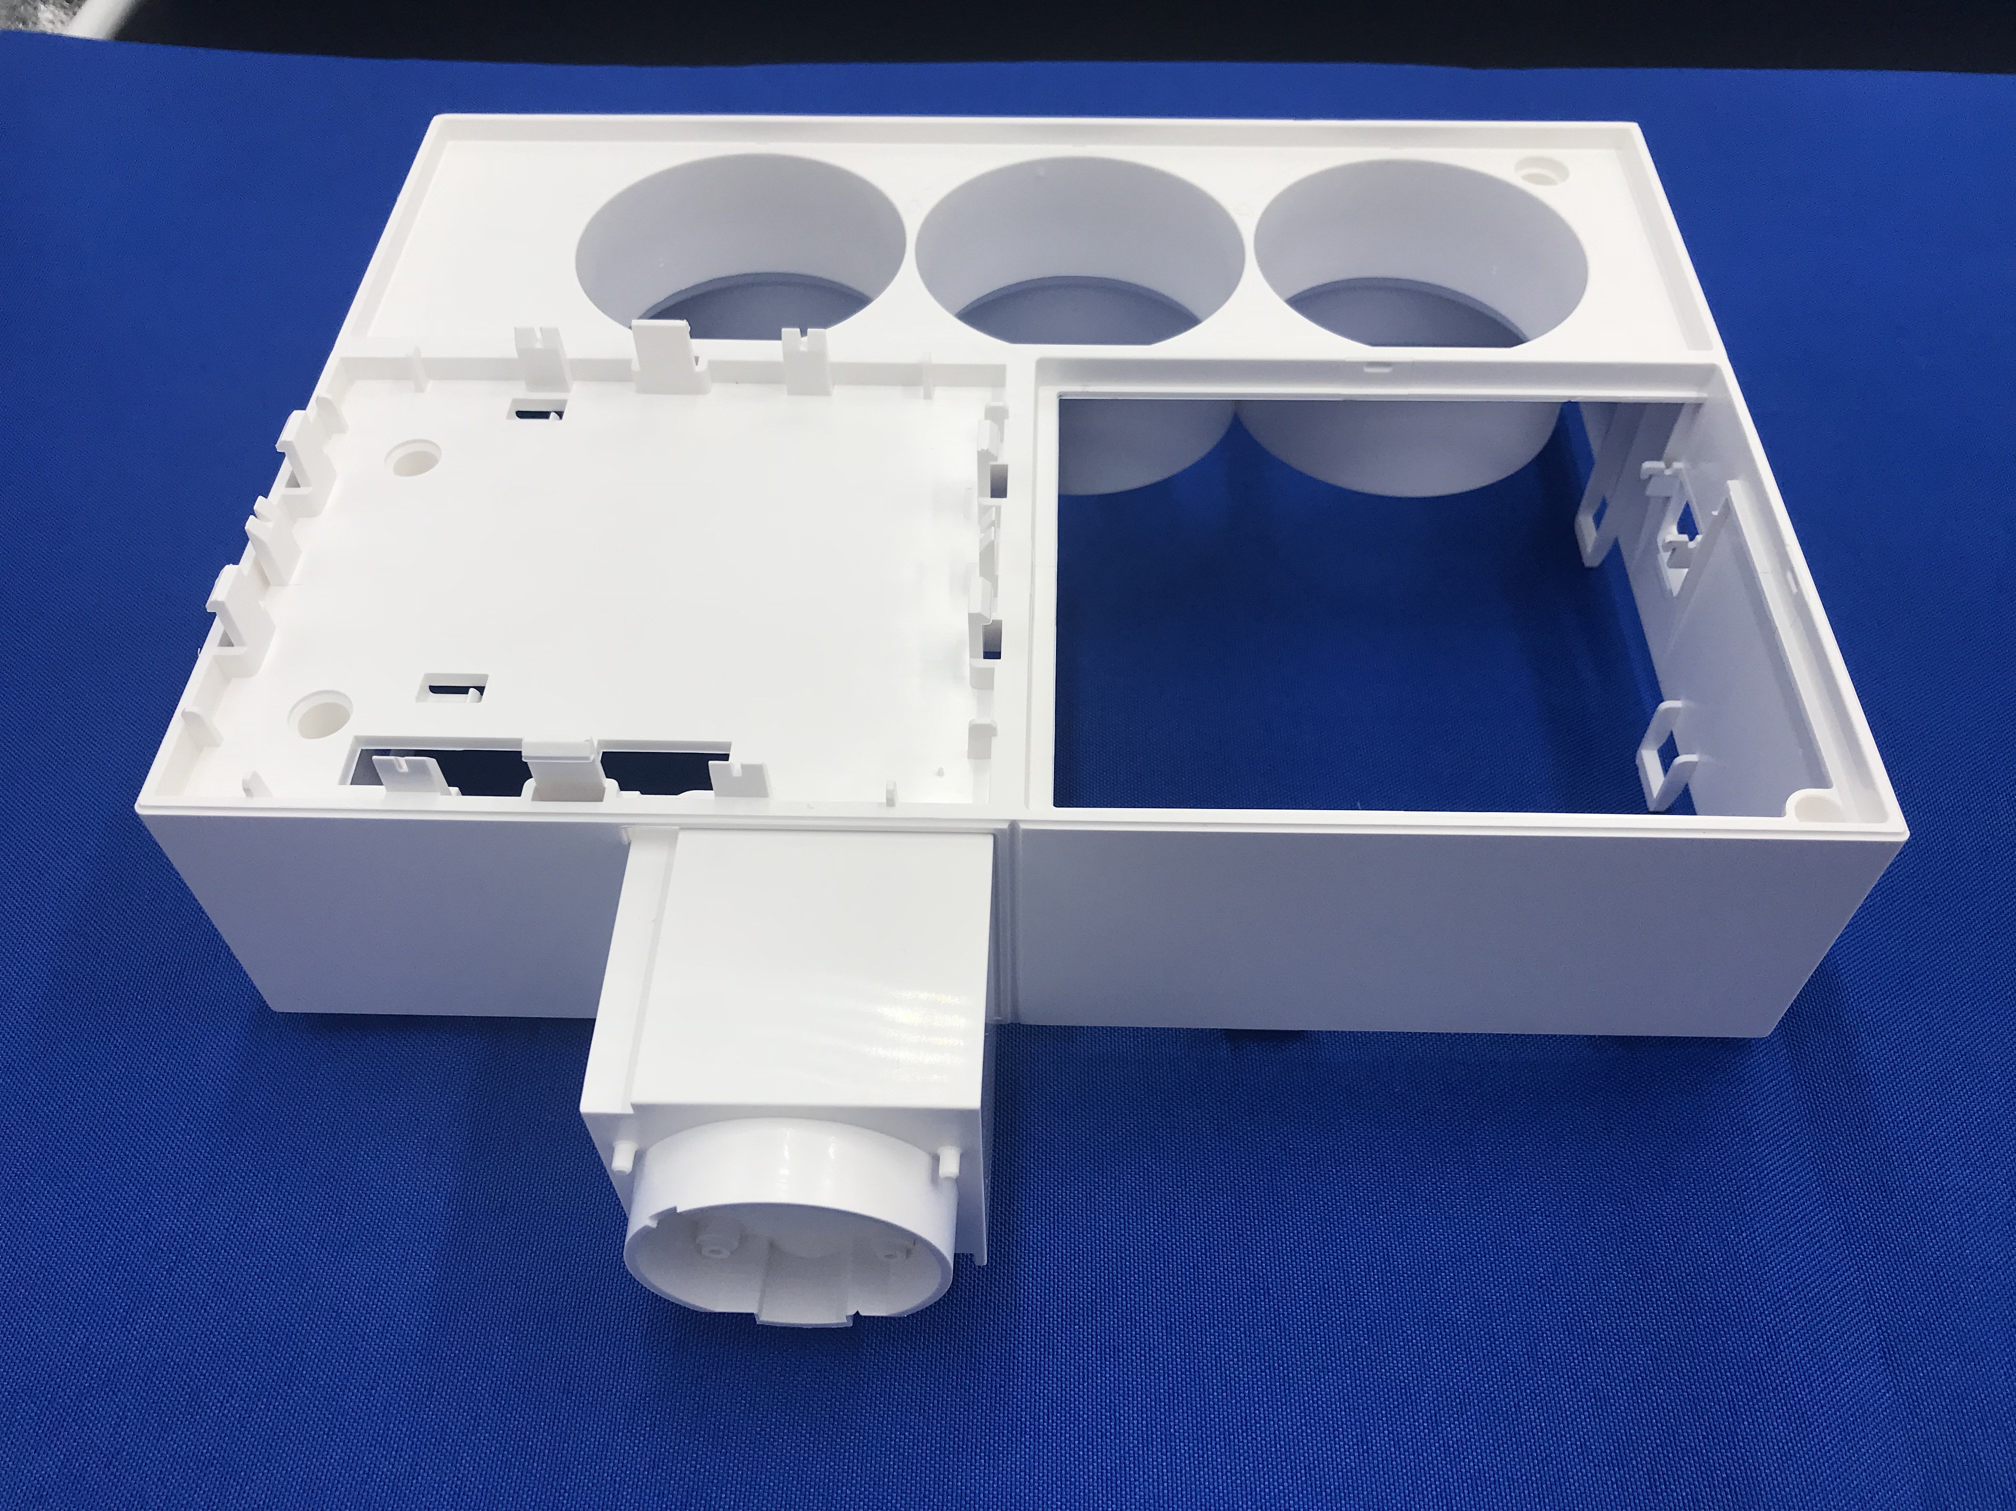
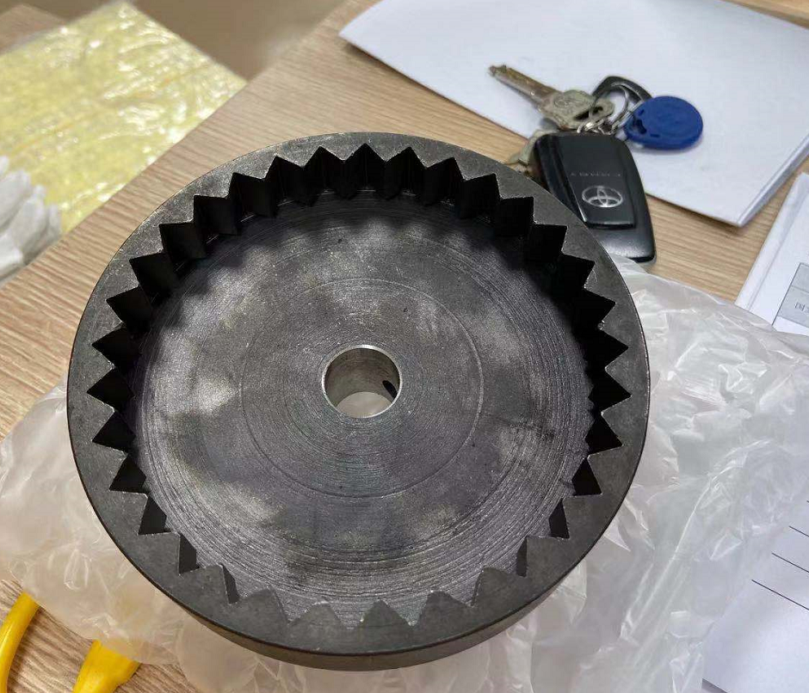
This presentation is intended primarily for those looking for new suppliers and manufacturers for CUSTOM MADE PRODUCTS.
CUSTOM MADE PRODUCTS are those that are manufactured according to your specifications, blueprints, design….etc.
Also the advise given in this presentation is worth pursuing if you are willing to establish long term relationships with suppliers.

Slide 3



Using TRADE AGENTS and TRAVELLING to the factory & visiting them….these can all be BENEFITIAL, but many times the buyer will not have so much volume or the extra profit margin to pay for these services and expenses. These are COSTLY !
Doing the homework properly by yourself REMOTELY over the internet, phone, Skype… will make it possible to succeed for almost NO COST and MAY ELIMINATE THE NEED TO VISIT PLANTS.

Slide 4

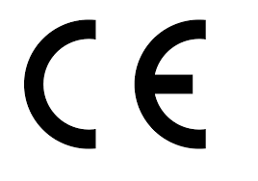


Ask potential suppliers for a copy of their QUALITY MANAGEMENT CERTIFICATIONS, such as ISO9001, QS9000, ISO14969....etc.
Make sure to CHECK who the ISSUING AGENCY is and how reputable the issuer is. Some agencies do thorough audits and are known for their seriousness while others basically "sell" certifications. You will need to do some research on this.
Similar to the above, ask your potential supplier whether they have ever sold a product that has other certifications & marks such as UL, CE, FDA, RoHS compliance, Electromagnetic Compatibility - US FCC approvals.....etc.

Slide 5



Ask your potential suppliers for a few customer references.
Pay attention to who the given references are ?
Find out when they last sold to that company or person ?
Even legitimate and good suppliers may not always provide references. Do not insist and do not take this as a red flag ! If they do give you good references which you can check and confirm, you should give a bonus point to those suppliers.

Slide 6
Another useful open sources intelligence technique is to check a potential supplier’s internet presence and how their name and website is performing.
Are they active on social media ? Youtube, Facebook, Twitter, Pinterest, Alibaba, MFG.com…..
Websites age, number of back links, page rank, appearance numbers ,SEO score and other scores and data.
Check for the quality of photos and spelling.
Check blogs and customer feedback, complaint records…etc. on the internet.
Even the faces of the plant workers on the photos can give you a good idea about the plant’s overall performance.

Slide 7
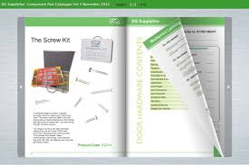

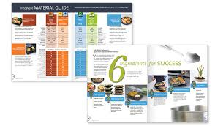

If the potential supplier/manufacturer does not have online downloadable company and product brochures and catalogs, ask them to send you a link to those or to email them to you.
Spelling mistakes ? Photos are clear or not ?
Do products illustrated in their catalogs show a logo or script, company name,....etc. ?
Truly successful suppliers usually hire good translators to avoid spelling and language mistakes, they take photos professionally using high resolution cameras, good cameramen.....they proudly show their logo and name on products and elsewhere etc.

Slide 8
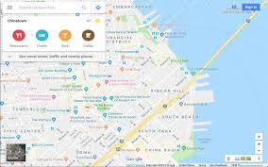
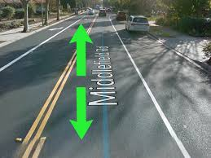

Use Google maps for aerial intelligence: On Google maps you can enter the supplier’s address and see the building from top, sometimes check the streets by drive through traffic and see the actual surrounding of the area. A company claiming to have 10,000 workers will mostly likely not fit into a 3000 square feet small building without even a parking lot. You can see all these from the satellite and street images on Google maps !

Slide 9
Examine the answers the supplier gave you carefully before ever engaging yourself further with an unknown supplier.
Are they vaguely answering your questions ? Do they skip to answer critical questions ?
Beware of a supplier who tells you just two hours after you send him detailed drawings, that he can provide a perfect product to you.
Beware of suppliers who make big mistakes on their quote sheets and information they send to you. – Especially big pricing mistakes, inch versus metric system misunderstanding ….
Beware of suppliers urging you to send money before fully understanding your needs.

Slide 10
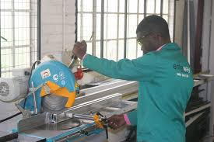
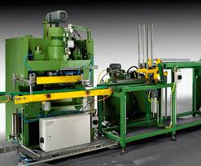
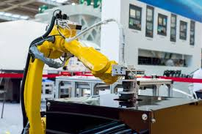
Try to get quotes from multiple potential suppliers if possible. Ideal price is generally speaking a little below the average price offered in the market, but NOT THE LOWEST !
Different suppliers have different equipment & expertise and the supplier who has the most suitable equipment, employee expertise and infrastructure to produce your product will most likely give you the best offer on all three: 1.) Quality 2.) Price, 3.) Lead Time. In other words, if your needs and requirements match the supplier's capabilities perfectly you should ideally hit three of these birds with one stone.

Slide 11
Call the potential supplier to see who answers the phone !
Are there indeed many people or is it always the same person ? Do they have a receptionist and separate phone numbers for different managers ?
Can you reach an English speaking person easily or do you end up not being able to understand a single word the person on the other side of the phone line tells you ?
Are you getting to someone who clarifies your questions quickly or are you being transferred from one guy to the next and finally someone hangs up on you ??
After calling them, close your eyes and ask yourself: "Did they answer my questions properly and professionally and make me feel comfortable ?"

Slide 12



If the value of your purchase is high, negotiate good payment terms and try not to put yourself under the mercy of your chosen supplier. You may try negotiating a 30% advance payment with order and remaining amount after inspecting first articles. Or 50% with order, remaining 50% after first articles inspection and approval and just before shipment.
If you are outsourcing to China or any other foreign country, do not expect a net 30 days or 60 days term with your first order.
If the payment is for a mold or tooling, then it is very normal to expect the supplier to ask you for full payment of the mold / tool in advance.

Slide 13
There are many other techniques and methods you can use for free. These are just some that are effective. Do use as many of these techniques as possible and others to make sure you have found the right supplier for your product needs.
Also keep in mind that none of the above methods should be taken as a single criteria in making a purchasing decision. Instead, the overall score or picture from your evaluation combined with proper interpretation and commonsense should lead you to decisions. There are many small shops and manufacturers who are actually good but would probably perform badly on the above listed evaluation criteria. Be aware of this fact too ! On the other hand, we are here for you, with an already well established manufacturing basis and network you can benefit from if you need to have something custom manufactured.
Please subscribe to our channel and visit us at http://www.agstech.net

