Slide 1


How You Can Receive the Best Quotes from Custom Manufacturers
Prepared by: AGS-TECH, Inc.
“Your one-stop shop for custom manufacturing”
Visit us at http://www.agstech.net

Slide 2
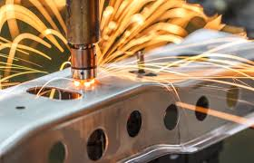

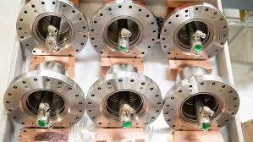
Manufacturing requests for non-standard components, assemblies and products. These are referred to as CUSTOM MANUFACTURING. In custom manufacturing; prices, lead times and quality can vary significantly from one offer to the other.
Ambiguities will only result in receiving quotes with higher prices so manufacturers do not have losses at the end of a project. Providing accurate and detailed information is critical for obtaining the best quotes.
A good idea is to ask manufacturers for their opinion to reduce prices. Don’t believe in every answer but don’t hesitate to ask. Analyze, research, evaluate, compare answers with your own design and specifications.

Slide 3


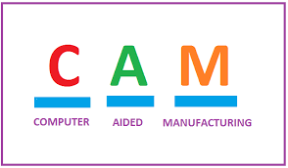

When an RFQ or RFP for a custom part or product is received, it is generally scheduled for engineering review meeting. Participants may come from various departments such as planning, quality control, engineering, packaging, sales…etc. and each makes its contribution for accurate calculation of lead times and cost. Various contributors to cost and standard lead times are added up, to come up with a total cost & lead time, from which a formal quote is drafted.
Some manufacturers use advanced software tools, like GROUP TECHNOLOGY, to obtain the most accurate quotes. Using Group Technology, new part designs can be developed using already existing and similar designs, saving a significant amount of time and work. Product designers can determine fast whether data on a similar component already exists in the computer files. Custom manufacturing costs can more easily be estimated and the relevant statistics on materials, processes, number of parts produced, and other factors can easily be obtained. Process plans are standardized and scheduled more efficiently, orders are grouped for more efficient production, machine utilization is optimized, set-up times are lowered, components & assemblies are manufactured more efficiently and with higher quality. Similar tools, fixtures, machines are shared in the production of a family of parts.

Slide 4
WHAT INFORMATION SHOULD YOU PROVIDE MANUFACTURERS TO GET
THE BEST PRICE QUOTE WITHIN SHORTEST TIME ?
- 2D Blueprints (technical drawings) of parts and assemblies. Blueprints should clearly show dimensions, tolerances, surface finish, coatings if applicable, material information, blueprint revision number or letter, Bill of Materials (BOM), part view from different directions…etc. These can be in PDF, JPEG format or else.
- 3D CAD files of parts and assemblies. These can be in DFX, STL, IGES, STEP, PDES format or else.
- Quantities of parts for quote. Generally, the higher the quantity the lower will be the price in the quote (please be honest with your actual quantities for quote).
- If there are off-the-shelf components that are assembled with your parts, please feel free to include them in your blueprints. If assembly is complicated, separate assembly blueprints help much in the quotation process. Manufacturers may buy and assemble the off-shelf components into your products or custom manufacture depending on the economic viability.
- Clearly indicate whether you want manufacturers to quote individual components or a subassembly or an assembly. This will save time and hassle in the quotation process and eliminate expensive misunderstandings.
-Shipping address of parts for quote. This helps quote shipping in case you do not have a courier account or forwarder.
- Indicate whether it is a batch production request or a long term repeat order that is planned. A repeat order over long term generally receives a better price quotation. A blanket order does generally also receive a better quote.
- Indicate whether you want special packaging, labeling, marking…etc of your products. Indicating all your requirements in the beginning will save both parties time and effort in the quotation process. If not indicated at the beginning, manufacturers will likely need to re-quote later and this will only delay the process.
If you need an NDA signed prior to quoting your projects, email them.
NDA should ideally cover both sides.
- Send samples to manufacturers if parts are complicated.

Slide 5


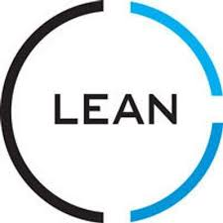




WHAT PRODUCT DESIGN CONSIDERATIONS SHOULD YOU HAVE GONE THROUGH TO GET THE BEST PRICE QUOTE WITHIN SHORTEST TIME ?
- Is it possible to simplify product design and reduce the number of components for a better quote without adversely affecting intended functions and performance ? Can product design be simplified for a simpler manufacturing process ?
- Were environmental considerations taken into account and incorporated into material, process and design ? Environmentally polluting technologies have higher tax burdens and disposal fees and thus indirectly result in us quoting higher prices.
- Have you investigated all alternative designs ? Ask manufacturers whether changes in design or material would make the price quote lower. Alternatively you may send manufacturers several designs and compare quotes on each.
- Can unnecessary features of the product or its components be eliminated or combined with other features ?
- Have you considered modularity in your design for a family of similar products and for service and repairs, upgrading and installation ? Modularity can lower overall prices as well as reduce service and maintenance costs in the long term. For example a number of injection molded parts made of the same plastic material can be manufactured using mold inserts.
- Can the design be made lighter and smaller ? Lightweight and smaller size results in better product quotes and saves you on shipping cost.
- Have you specified unnecessary and excessively stringent dimensional tolerances and surface finish ? The tighter the tolerances, the more stringent the surface finish the higher the price quote. For the best quote, keep it as simple as needed.
- Will it be excessively difficult and time consuming to assemble, disassemble, service, repair and recycle the product ? If so, the price quote will be higher. Keep it as simple as possible for the best price quote.

Slide 6


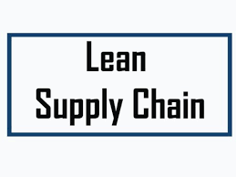


- Have you considered subassemblies ? The more value added services are added to your product such as subassembly, the better the quote may be. The overall cost of procurement can be much higher if you have several manufacturers get involved in quoting.
- Have you minimized the use of fasteners, their quantities and variety ? Fasteners result in higher price quotation. If easy snap-on or stacking features can be designed into the product it may result in a better price quote.
- Are some of the components commercially available ? If you have an assembly for quote, please indicate on your drawing if some components are available off-the-shelf. Sometimes it is less expensive if manufacturers buy and incorporate these components instead of manufacturing them. Their manufacturer may be producing them in high volume and give you a better quote than someone manufacturing them from scratch especially if the quantities are small.
- If possible, choose the safest materials and designs. The safer it is, the lower will be the price quote.

Slide 7


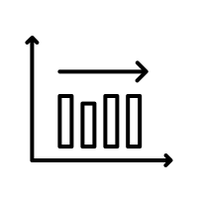
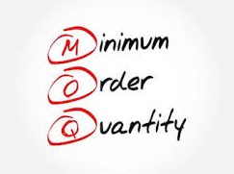
WHAT MATERIAL CONSIDERATIONS SHOULD YOU HAVE GONE THROUGH TO GET THE BEST PRICE QUOTE WITHIN SHORTEST TIME ?
- Did you select materials with properties that unnecessarily exceed minimum requirements and specifications ? For the lowest quote, try to use the least expensive material that meets or exceeds expectations.
- Can some materials be replaced with less expensive ones ? This naturally lowers the price quote.
- Do the materials you selected have the appropriate manufacturing characteristics ? If not, it may take more time to manufacture the parts, there may be more tool wear and thus a higher price. Don’t make a part from tungsten if aluminum does the job.
- Are raw materials needed for your products available in standard shapes, dimensions, tolerances, and surface finish ? If not, the price quote will be higher due to additional cutting, grinding, processing…etc. (example: sheet metal thickness)
- Is the material supply reliable ? If not, quotes may well be different each time you reorder the product. Some materials have rapidly and significantly changing prices in the global marketplace. Quote will be better if the material used is plenty and has a stable supply.
- Can raw materials chosen be obtained in the required quantities in the desired timeframe ? For some raw materials, suppliers have Minimum Order Quantities (MOQ). If quantities requested are low, it may be impossible to get a price quote from the material supplier. For some exotic materials, procurement lead times may be too long.

Slide 8
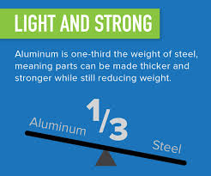

- Some materials are able to improve assembly and even facilitate automated assembly. This may result in a better price quote. For example, a ferromagnetic material may easily be picked and placed with electromagnetic manipulators. Automation can lead to a much better quote especially for high volume production.
- Choose materials that increase stiffness-to-weight and strength-to-weight ratios of structures whenever possible. This will require less raw material.
- Comply with legislation and laws limiting the use of environmentally destructive materials. This approach will eliminate high disposal fees for destructive materials.
- Choose materials that reduce performance variations, environmental sensitivity of products, improve robustness. This way, there will be less manufacturing scrap and rework. (Ex: Made at low temperature and does not mount in summer)

Slide 9





WHAT MANUFACTURING PROCESS CONSIDERATIONS SHOULD YOU HAVE GONE THROUGH TO GET THE BEST PRICE QUOTE WITHIN SHORTEST TIME ?
- Have you considered all alternative processes ? Price quote can be surprisingly lower for some processes as compared to others. You may choose the most suitable process together with the manufacturer. (Ex: casting versus machining)
- What are the ecological impacts of the processes ? Try to choose the most ecologically friendly processes. This will result in a lower price quotation because of lower environment related fees.
- Are the processing methods considered economical for the type of material, shape produced, and production rate ? If these match well with the processing method, you will receive a more appealing quote.
- Can requirements for tolerances, surface finish, and product quality be met consistently with the chosen process ? The more the consistency, the lower the price quote and the shorter the lead time.
- Can your components be produced to final dimensions without additional finishing operations ? If so, this will give the opportunity to quote lower prices.
- Is the tooling required available or manufacturable at chosen plants ? Or can they purchase it as an off-shelf item ? If so, they can quote better prices. If not they will need to procure and add it to quote. For best quote, try to keep designs and required processes as simple as possible. Prefer off-the-shelf or standard tools. (Ex: Extrusion dies for pipes….etc.)

Slide 10


- Did you think of minimizing the scrap by choosing the right process ? The lower the scrap, the lower the quoted price. Manufacturers may be able to sell some scrap and deduct from the quote in some cases, but most of the scrap metal and plastics produced during processing are of low value. (Ex: Extruding may reduce scrap as compared to machining)
- Give manufacturers the opportunity to optimize all processing parameters. This will result in a more appealing quote. For example, if four weeks lead time is good for you, don’t insist on two weeks which will force manufacturer to machine parts faster and therefore have more tool damage, as this will be calculated into the quotation.
- Have you explored all the automation possibilities for all phases of the production ? If not, reconsidering your project along these lines can result in a lower price quote. (think along DFM – Design For Manufacturability line)
- Some manufacturers implement Group Technology for parts with similar geometries and manufacturing attributes. You will receive a better quotation if you send over RFQs for more parts with similarities in geometry, design and material. If they evaluate them at the same time together, they will most likely quote lower prices for each (with the condition that they are ordered together). Material MOQ can be met more easily, tools may be shared….etc.
- If you have special manufacturing, inspection and quality control procedures to be implemented, make sure they are useful and not misleading. Manufacturers cannot take responsibility for mistakes arising due to ill-designed procedures imposed on them. Generally speaking, quotes are more appealing if manufacturers implement their own procedures.
- For high volume production, generally quotes will be better if manufacturer manufactures all components in your assembly. However, sometimes for low volume production, final quote can be lower if they can purchase some of the standard items that go into your assembly. Consult with manufacturers prior to making a decision.

Slide 11
A Few Final Words………………
There are many other things of importance to obtain the best offers and quotes from manufacturers. These are just some of the important ones. Do consider as many of these as possible and others to make sure you have found the right supplier for your product needs. Price is definitely NOT everything. Quality, Price, Lead Time along with many other factors should be considered when choosing a manufacturer.
Also keep in mind that none of the above suggestions and advice should be taken as a firm rule. Instead, your own circumstances and evaluation combined with proper interpretation and commonsense should pave the road to decisions on how to proceed when approaching manufacturers.
We are here for you, with an already well established manufacturing basis and network you can benefit from if you need to have something custom manufactured.
Please subscribe to our channel and visit us at http://www.agstech.net

